Slide 1
Building Applications for Relativity and RelativityOne

Slide 2
Chandra Alimeti
Maria Marinova
Carlos Torres

Slide 3
Relativity Templates
Publish to Relativity
Unit Tests
Integration Tests
Run Integration Tests as CI
Gravity API

Slide 4
Getting Started

Slide 5
You should see a PDF on your workshop machine’s desktop.
This document contains all the instructions for today’s workshop.
Workbook
Document

Slide 6
Follow instructions on Section 2.1 on Page 4 to access the various projects that will be used in the workshop.
Workshop Projects

Slide 7
Follow instructions in Section 2.2 on Page 5 to setup DevVM for accessing Relativity.
DevVM Setup

Slide 8
Visual Studio Templates

Slide 9
Visual Studio project templates + NuGet Packages
Creating a Relativity Application
Develop a Relativity Event Handler
Publish to Relativity
Section Overview

Slide 10
Pre-created class files
Overridable functions
Auto-filled class attributes
GUID
Execution type
Version specific
Generally work across versions
Visual Studio Marketplace
Visual Studio project templates

Slide 11
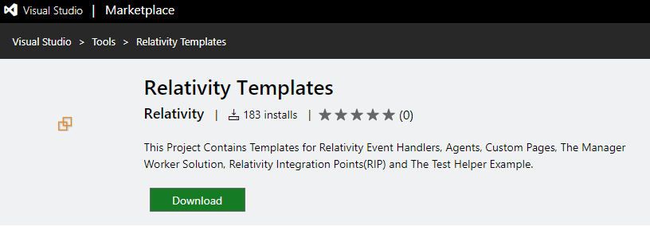
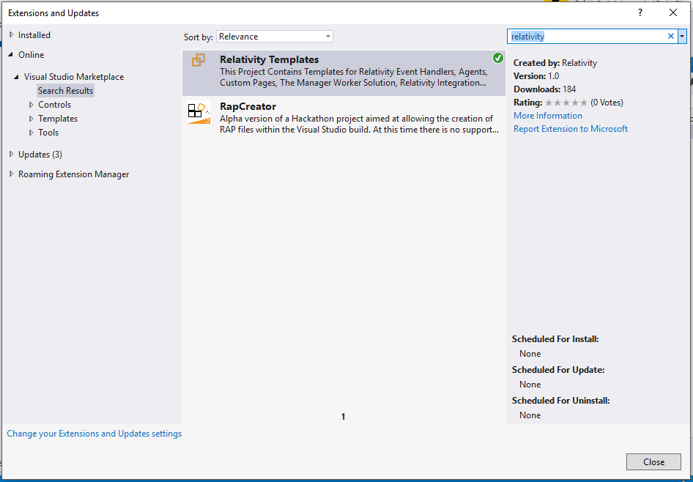
Visual Studio project templates

Slide 12
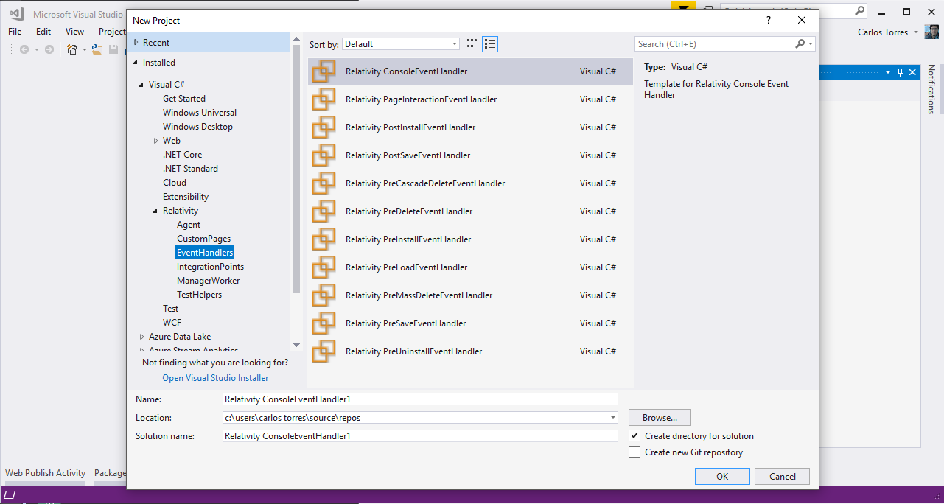
Visual Studio project templates

Slide 13
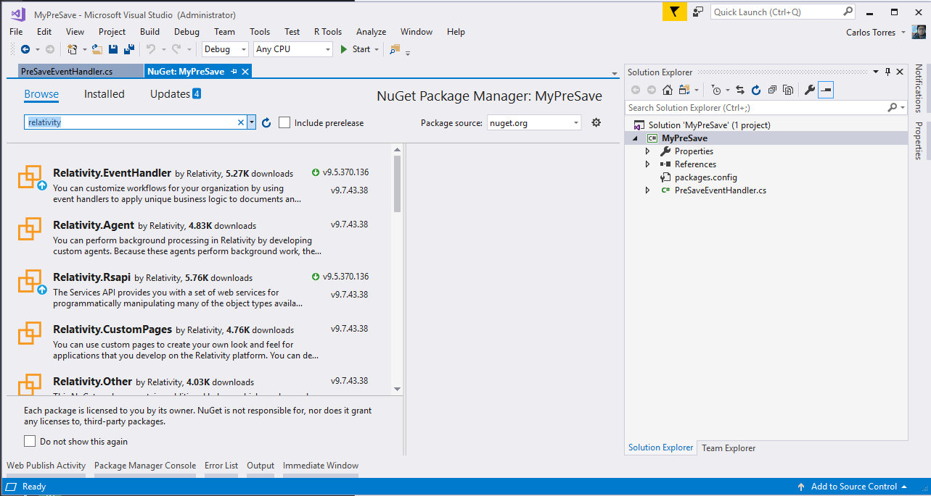
NuGet packages

Slide 14
Extend Relativity
Customized workflows
Custom Objects (RDOs)
Extensibility Points
Event Handlers
Agents
Custom Pages
Exportable to other workspaces/instances
Relativity Applications
Overview

Slide 15
Event handlers
Pre/post save
Pre/post install
Page interaction
Agents
Background processes
Custom page
Customize UI
Extensibility Points Overview

Slide 16
Quick upload of application files
Resource files
Custom pages
Set your configuration and publish with a Click!
Publish to Relativity

Slide 17
Visual Studio Templates
Section 3 Page 9

Slide 18
Create a Relativity Application
"Build your first application"
Develop a Relativity Event Handler
"Build your first event handler"
Visual Studio Templates
"Visual Studio templates"
Publish to Relativity
"Publish to Relativity tool"
Documentation
References

Slide 19
Sample Application

Slide 20
Sample Application Overview
Section Overview

Slide 21
The Sample Relativity application consists of the following
Custom Object
Instance Metrics Job
Fields
Metrics
Status
Workspaces Count
Users Count
Groups Count
Errors
Event Handler
PreSaveStatusUpdate
Agent
Instance Metrics Calculator Agent
Sample Application Overview

Slide 22
Sample Application
Section 4 Page 22

Slide 23
Unit Tests

Slide 24
Find software bugs early
Facilitates change
Simplifies integration
Provides documentation
Unit Tests

Slide 25
Unit Tests
Section 5 Page 27

Slide 26
Integration Tests

Slide 27
Necessary to verify whether the software modules work in unity
Test custom applications when new versions of Relativity are released
RelativityOne and integration tests
Relativity test helpers for integration tests
Open source project on Github
https://github.com/relativitydev/relativity-test-helpers
Integration Tests

Slide 28
Integration Tests
Section 6 Page 34

Slide 29
Gravity API

Slide 30
Developed by TSD
https://www.tsd.com/
Open source project on Github
https://github.com/tsdservices/gravity
CRUDQ Framework for Relativity Custom Development using .NET objects
Easy to work with as data is returned in the form of .NET objects; all the field conversions are done for you by Gravity.
Prevent any future issues caused by changes in Relativity APIs
NuGet package
https://www.nuget.org/packages/Gravity/
Gravity API

Slide 31
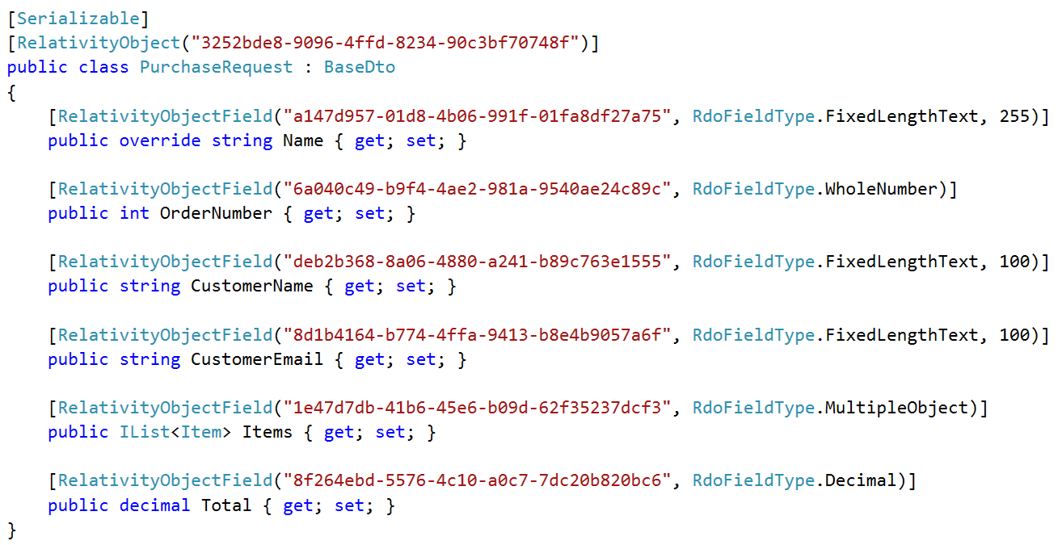
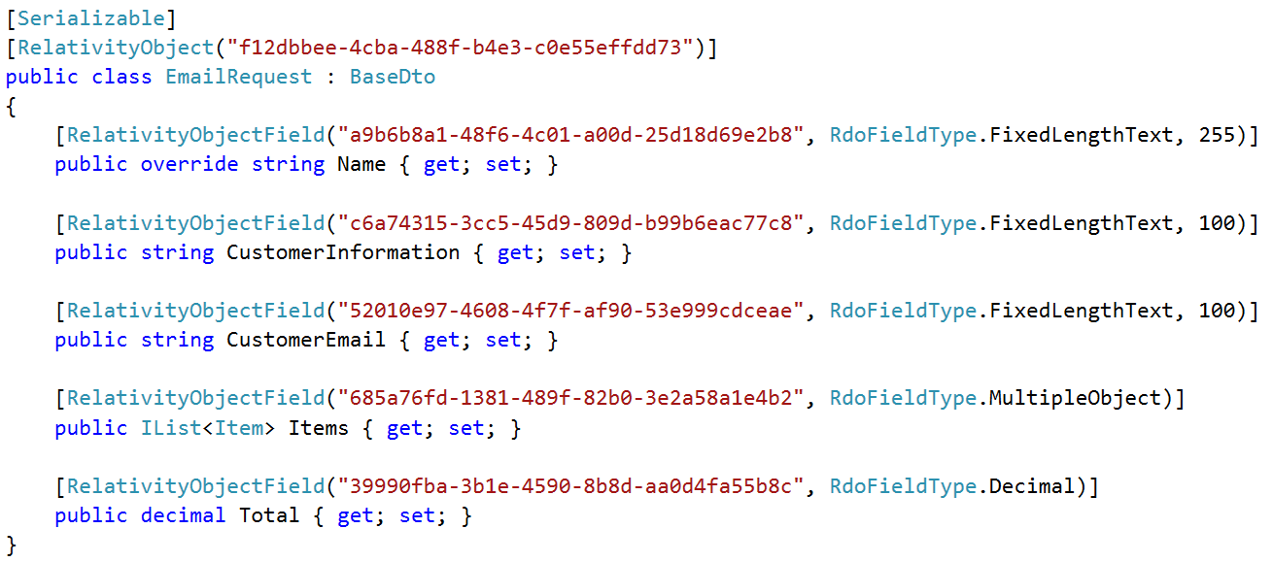
Example Models – PurchaseOrder & EmailRequest

Slide 32
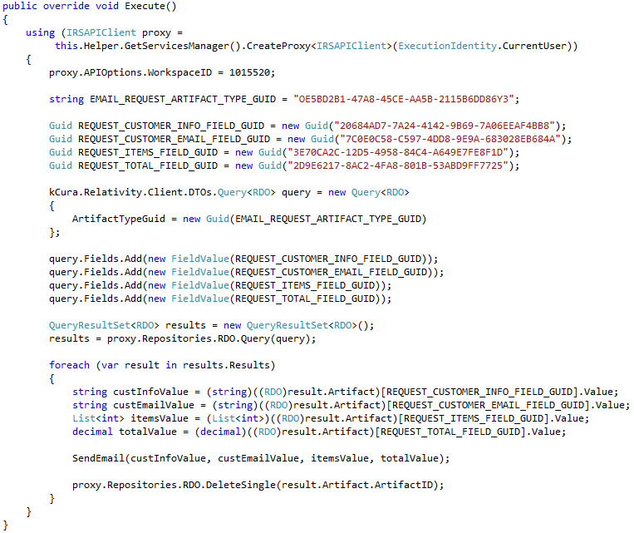
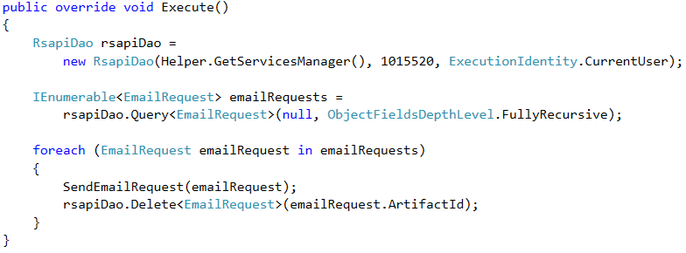
Before Gravity vs. After Gravity – (Agent Example)

Slide 33
PR225233 - Gravity: An Open Framework for Relativity Developers
Need more information? Stop by TSD’s booth.
Fest Session

Slide 34
Gravity API
Section 7 Page 44

Slide 35
Relativity Community (community.relativity.com)
Developer Group
DevHelp Community (devhelp.relativity.com)
RelativityDev GitHub (relativitydev.github.io)

Slide 38
Questions?

